Slide 1
Customer Retention Project
By Miral Dhrafani

Slide 2
Table of Content
Introduction
Analytical Problem Framing
Data Source and their Formats
Data Preprocessing
Hardware and software used
Data Visualization
Conclusion

Slide 3
Introduction
Customer satisfaction has emerged as one of the most important factors that guarantee the success of online store; it has been posited as a key stimulant of purchase, repurchase intentions and customer loyalty. A comprehensive review of the literature, theories and models have been carried out to propose the models for customer activation and customer retention. Five major factors that contributed to the success of an e-commerce store have been identified as: service quality, system quality, information quality, trust and net benefit. The research furthermore investigated the factors that influence the online customers repeat purchase intention. The combination of both utilitarian value and hedonistic values are needed to affect the repeat purchase intention (loyalty) positively. The data is collected from the Indian online shoppers. Results indicate the e-retail success factors, which are very much critical for customer satisfaction.

Slide 4
Introduction (Contd)
Shopping or buying new things is a never ending process and with the advancement of internet the way of shopping has also changed, now everybody wants to get new things without leaving their home and with this change in human behaviour a new business form has been evolved, Online retail business and with the increasing use of internet, the popularity of online business has already increased, with the result of which, online marketplace is one of the widely used marketplace in the whole world, lots of player have joined this league, by promoting or selling their products online and this made online retail business highly competitive.
The data-set was provided by flip Robo Technologies fo detailed analysis of customer database, in the growing world of online business, new players are entering the market each day, so it is very important for the business to conduct depth analyse to grow their business, the business wants to know how the customer feels about the shopping through their app or website such as sense of financial security or availability of various choices or variety of products, so that they can provide. It is very important for business to analyze and identify the trends through the data before implementing any predictive model or algorithm

Slide 5
Analytical Problem Framing
Data Source and format
data provided by Flip Robo Technologies
Two CSV files - one Raw and second Encoded
shape of the data - 269 Rows and 71 columns
combination of different types of data:
Demographic data - (gender,Age,cities)
5 point Likert scale ( strongly Agree, agree, disagree)
selection of mobile app ow websitt based on overall experience
Data Preprocessing
Checked for the null

Slide 6
Analytical Problem Framing (contd)
Data Preprocessing
First we checked the the data set for any null values, using python command, then we has a glimpse of all the columns in the data-set and then we checked how many unique values we have in each column that we we came to the conclusion that all the columns in the data set are categorical
Hardware and software requirement and tools used
A PC with pre-install Anaconda Navigator has been used, Jupiter Notebook was used as a platform to run Python, different python libraries were used such as pandas for data manipulation, numpy for calculations and sea-born and matplotlib for visualization

Slide 7
Analysis and visualization
Using pandas, Seaborn and Matplotlib

Slide 8
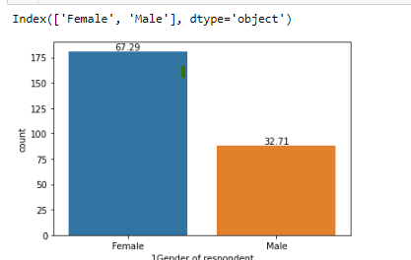
Distribution of Data based on Demographic Information
around 68% of the respondent are female however only 32% of the respondents are male

Slide 9
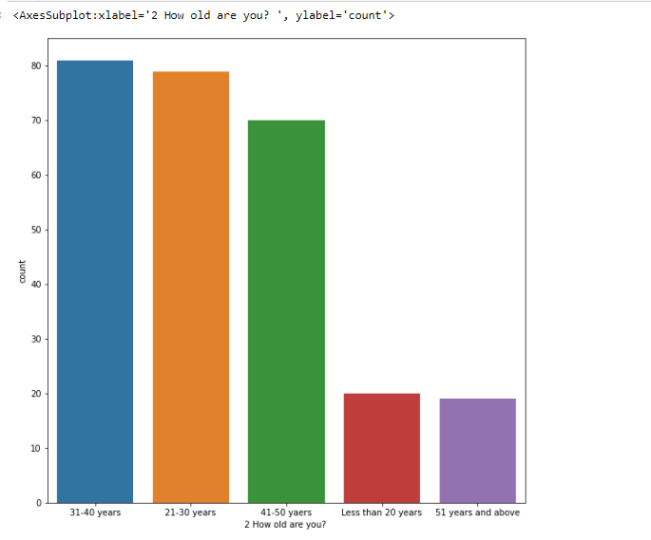
Age Group
•
majority of the shopper belongs to the 31-40 age group followed by 21-20 age group, however the youngest and eldest age group are least involved in online shopping

Slide 10
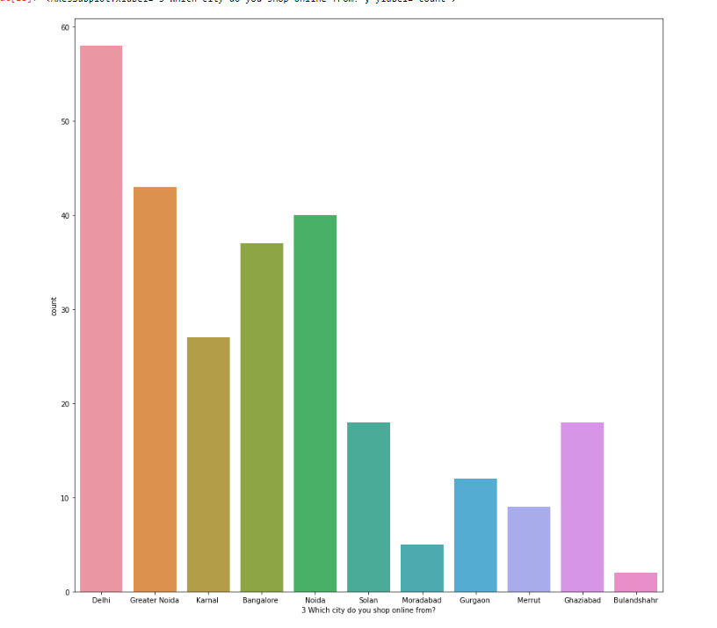
Location
•
most of the online shoppers belongs to the major cities such as Delhi, Bangalore and Noida, however people from smaller cities are less involved in shopping online

Slide 11
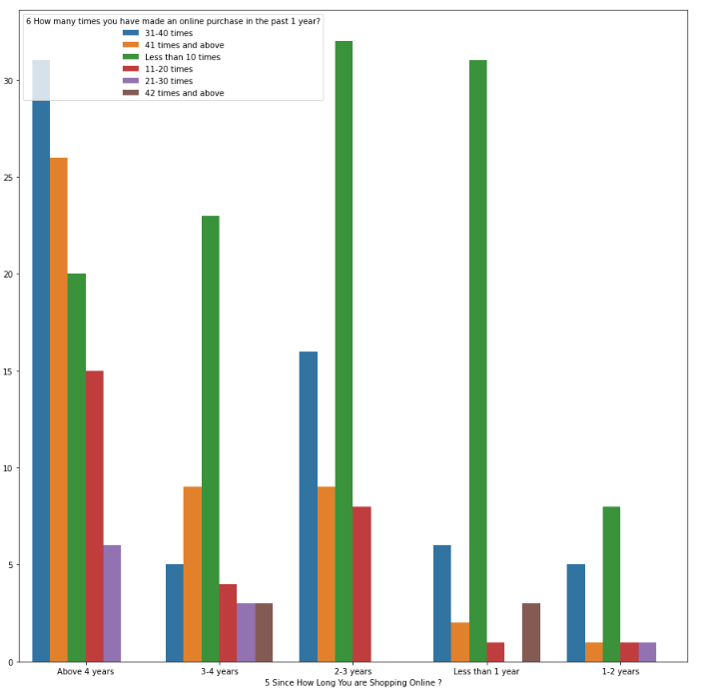
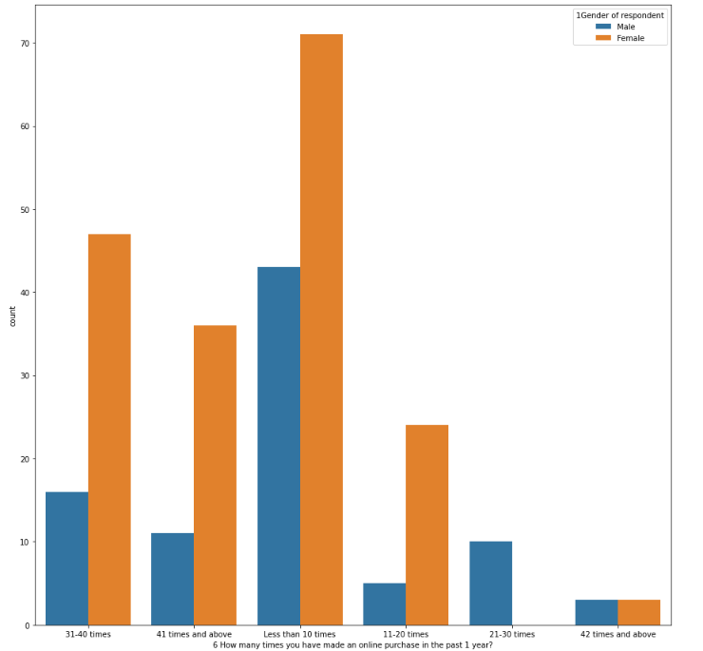
Comparing Time span of a customer with frequency of Purchase
Frequency of purchase based on Gender
when we compare time span of online consumer with the frequency we see that new consumers are tends to shop less frequently, however the oldest consumer tends to shop 31-40 times a year
here we see that females are more frequent online buyer as compared to male

Slide 12
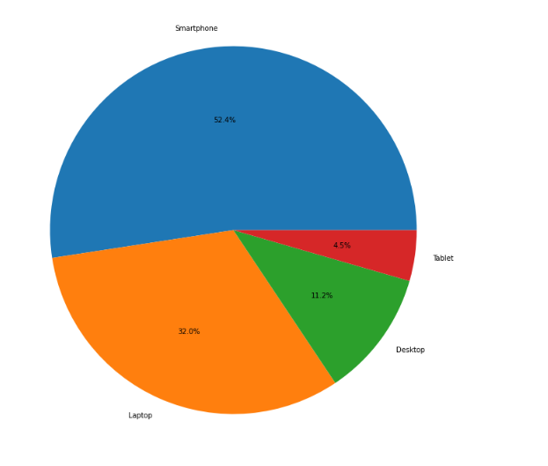
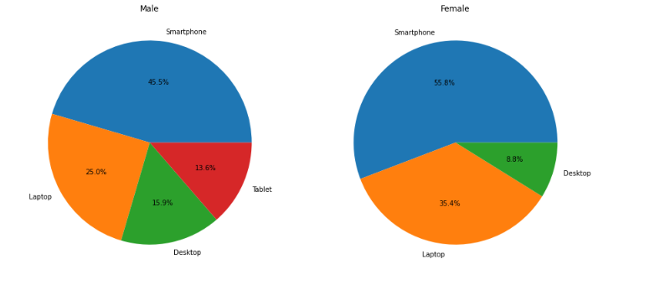
Distribution of data by device used for shopping
Distribution of data by device used for shopping bifurcated by Gender
more than 50% of the users use smart phone as the source for online shopping, followed by Laptop which is 32%
smart phone, is the dominant device for shopping online for both the genders however we noticed that female shopper dont use tablets for shopping purposes

Slide 13
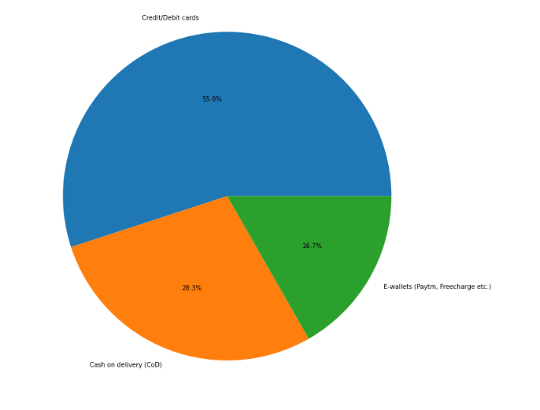
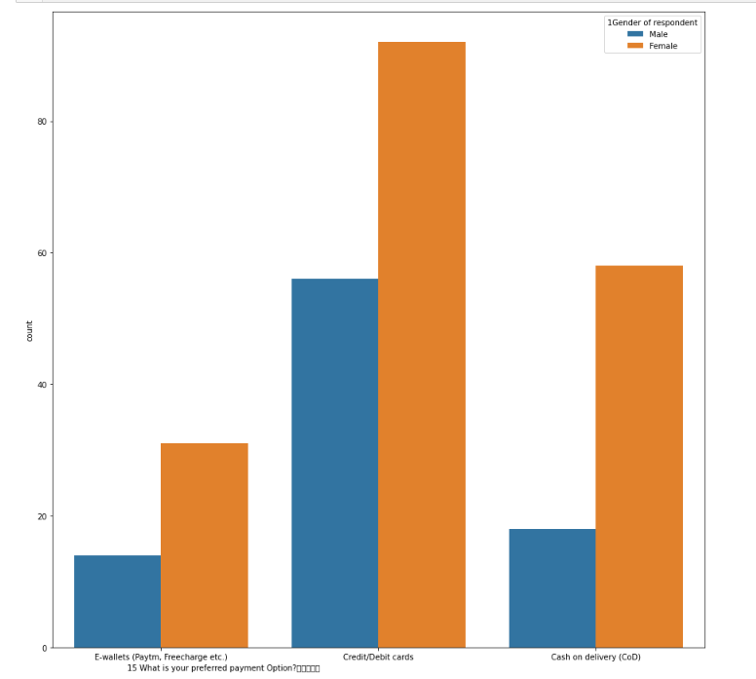
Distribution of Data by payment method
Distribution of Data by payment method bifurcated by Gender
here we see an interesting trend that more than 50% of the respondent uses credit/debit card to make the payment, however only 28.3% of the respondents uses COD
Inspite of Credit/debit card being the most preferred mode of payment by the user, but when we bifurcate it by gender we can see that COD is quite popular among female respondents

Slide 14
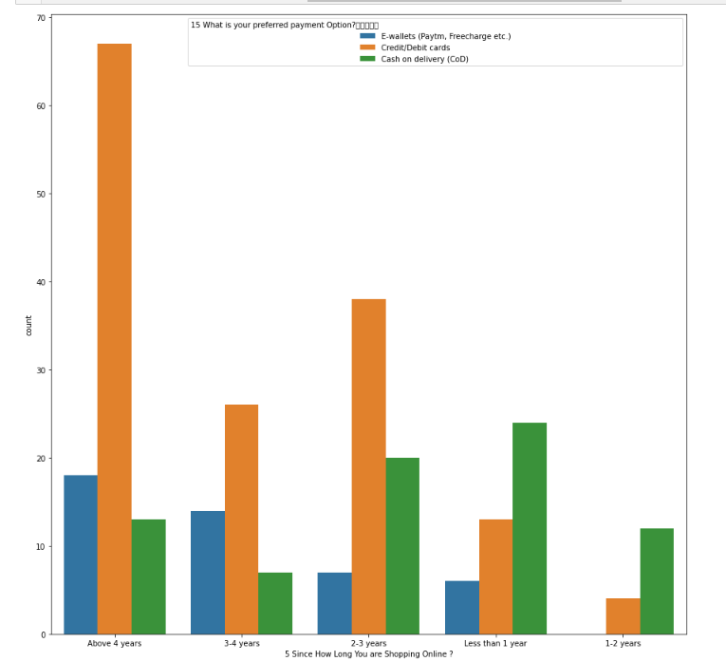
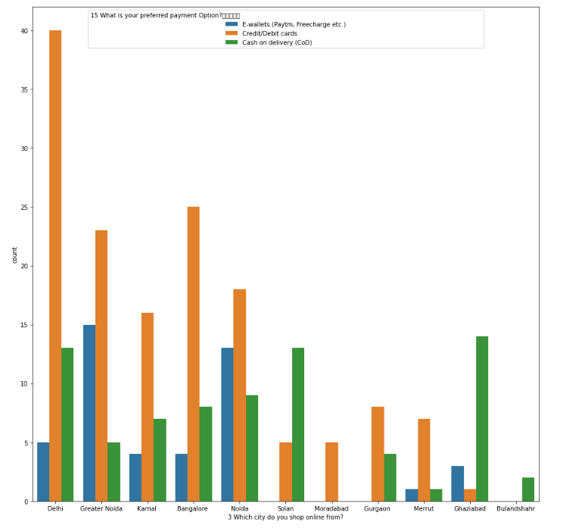
Distribution of Data by payment method bifurcated by Time span of a customer
Distribution of Data by payment method bifurcated by Cities
Here we see that new customer are more reluctant to use any digital form of payment and they often use COD(Cash on delivery), however old customer have developed trust in the app or website. Hence they more likely to use digital form of payment such as credit card or ewallet, for these typ of customer COD is the least preferred option
here we can see that shoppers from bigger cities like Delhi , Bangalore, Noida, Credit card is the most preferred mode of payment, but when we check the pattern of the smaller cities we see that people are more reluctant in using credit card or wallet, due to this COD is the most popular form of payment in these cities

Slide 15
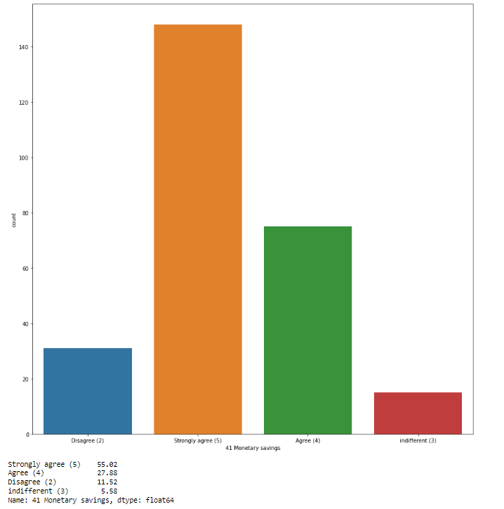
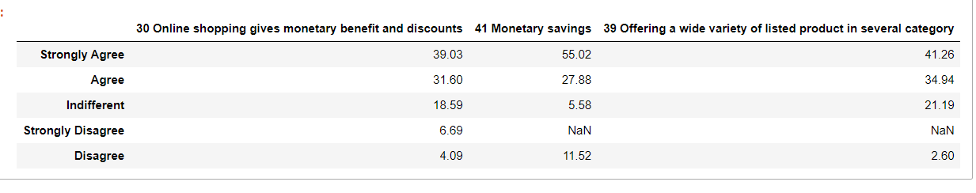
Monetory Saving
by looking at the above table we can say that people prefer online shopping because it provides monetory discounts and savings and also because they get wide variety of produt when compared to shopping in person
more than 50% of the respondent believes that monetary saving is one of the reason for shopping online

Slide 16
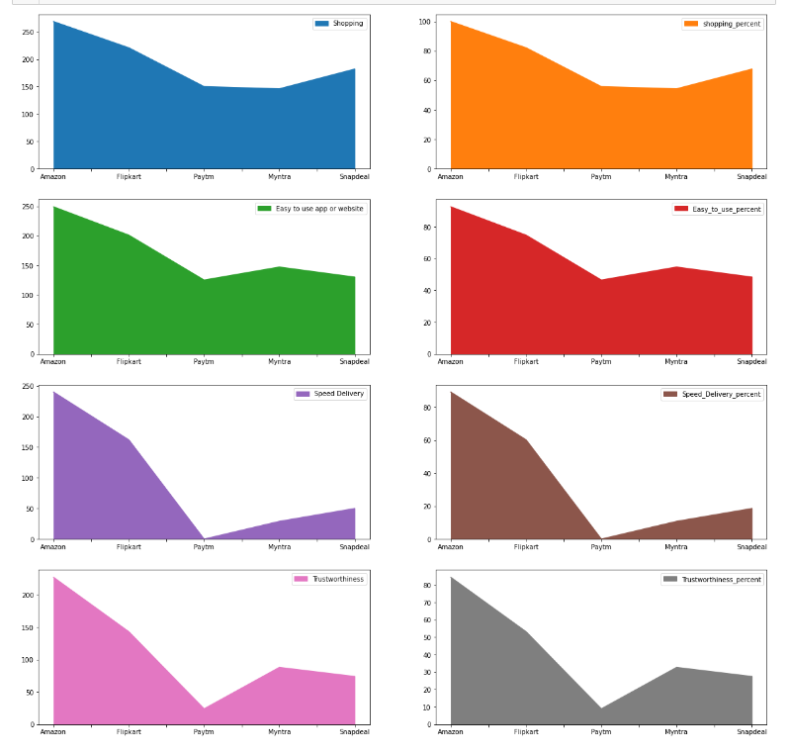
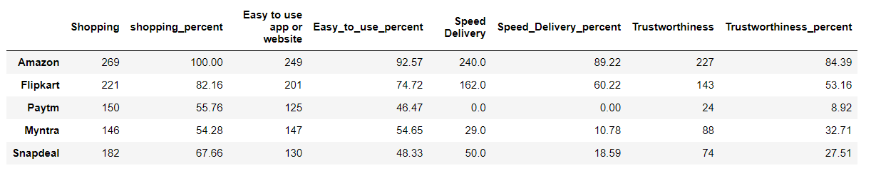
from the list of following features : speed, delivery, shopping and trustworthiness we can see that amazon is the most preferred shopping app or website because 100% of the respondent have used amazon for their shopping needs flipkart is the second preferred choice after amazon
more than 80% of the respondent believes that amazon have easy to use interface, provide fast delivery and have trustworthiness element
however, for flipkart the average rating is 70% for the above same parameters
least preferred brand of all is paytm, and in terms of delivery speed all the 269 believes that paytm have issues with the delivery speed

Slide 17
Conclusion
From the above analysis we can conclude that the buying behaviour and patterns of a consumer highy depends on the demographic details, for instance spending habits for male and female are completely differently, similarly consumer from smaller town or a new consumer payment methods can be completely different from a person who is purchasing from a metro cities or have spent years shopping online,
One more thing we can conclude from the above analysis is that trust on these shopping website or apps gradually increases from time to time, for example, new consumer are bit reluctant in sharing their financial information hence uses COD as the payment mode, however old consumer preferred using credit cards or ewallet

